Slide 1
Schwarzkopf Elementary PTA
1st PTA General Meeting
September 21st , 2022
6:00 pm

Slide 2
Schwarzkopf Elementary PTA 2022 – 2023 Board & Committee members
Position | Name | Email | Phone
EXECUTIVE BOARD
President | 22-23: Meghan McGuinness | schwarzkopfpresidentpta@gmail.com | 813-294-6008
^{1st} VP of Membership | 22-23: Cheryl Macri | schwarzkopfmembership@gmai.com | 740-590-9802
2ndVP of Ways and Means | 22-23: Jessica Meza | schwarzkopfwaysnmeans@gmail.com | 813-458-8474
3rd VP of Programs | 22-23: Samantha McCormick | schwarzkopfsponsorship@gmail.com | 813-462-6505
4th VP of Community Outreach | 22:23 Shadia Aoudai | schwarzkopfcares@gmail.com | 813-598-6633
Secretary | 22-23: Jenny Mun | ptaschwarzkopf@gmail.com | 813-943-9254
Treasurer | 22-23: Meaza Morrison | schwarzkopftreasurerpta@gmail.com | 813-841-6865
Teacher Liaison | 22-23: Dina Siembak | Dina.siembak@hcps.net
COMMITTEE CHAIRS
Bear Fest Coordinator | 22-23: Kyle Mobley (Chair) | kmobleyfl@yahoo.com | 813-546-9679
Family Fun Nights | 22-23: Helena Taranoff (Chair) | helena.taranoff@metlife.com | 703-232-7829
BoxTops | 22-22: Nikki Marshall (Chair) | nmarshall735@gmail.com | 813-679-5681
Bear Run | 22-23: Jeff Grim (Chair), Jian Faucher | jgrim@ut.edu, janice.hu@gmail.com | 740-591-6046
Holiday Shop | 22-23: Jessica Meza (Chair) | Jmeza0706@gmail.com, | 813-458-8474
Hospitality | 22-23: Allys J. Mendez Lopez (Chair) | allysjmendez@gmail.com | 561-460-3790
Volunteer/HR Parent Coordinator | 22-23: Kelly Hernandez (Chair) | kellyannhernandez@gmail.com | 954-895-8364
Junior Achievement | 22-23: Shadia Aoudai (Chair) | Shadia315@gmail.com | 813-598-6633
Memory Book | 22-23: Crystal Jackson (Chair) | crystal.jackson@hcps.net | 727-637-4905
Reflections | 22-23: Erin Robbins (Chair) | Erin.robbins@hcps.net | 412-527-7536
Spirit Sales | 22-23: Jenny Mun (Chair) | jmu911@yahoo.com | 813-943-9254
Teacher Appreciation Week | 22-23: Alyssa Taylor (Chair) | alyssataylor310@gmail.com | 813-679-3169
Marquee | 22-23: Nikki Marshall (Chair) | nmarshall735@gmail.com | 813-679-5681
Papa Bear | 22-23:
Schwarzkopf PTA General Email | www.Schwarzkopfpta.org | ptaschwarzkopf@gmail.com | 813-975-6945

Slide 3
Year At A Glance

Slide 4
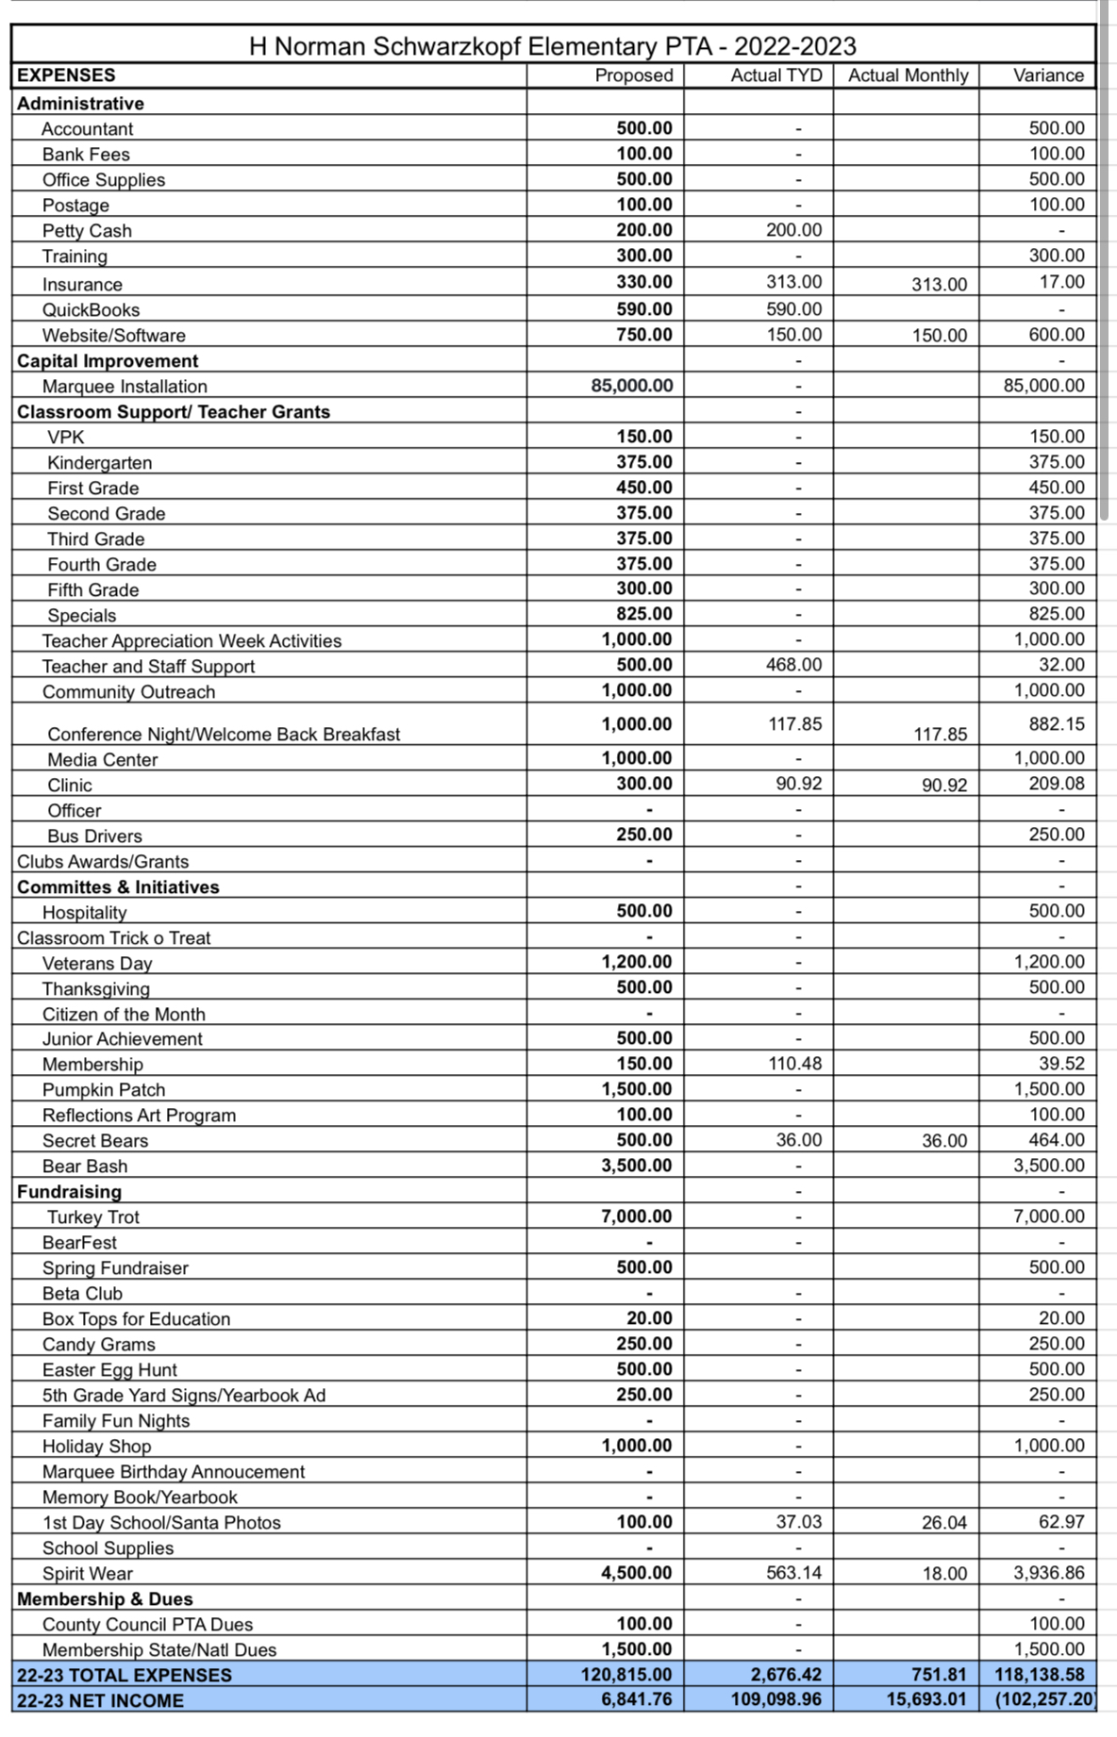
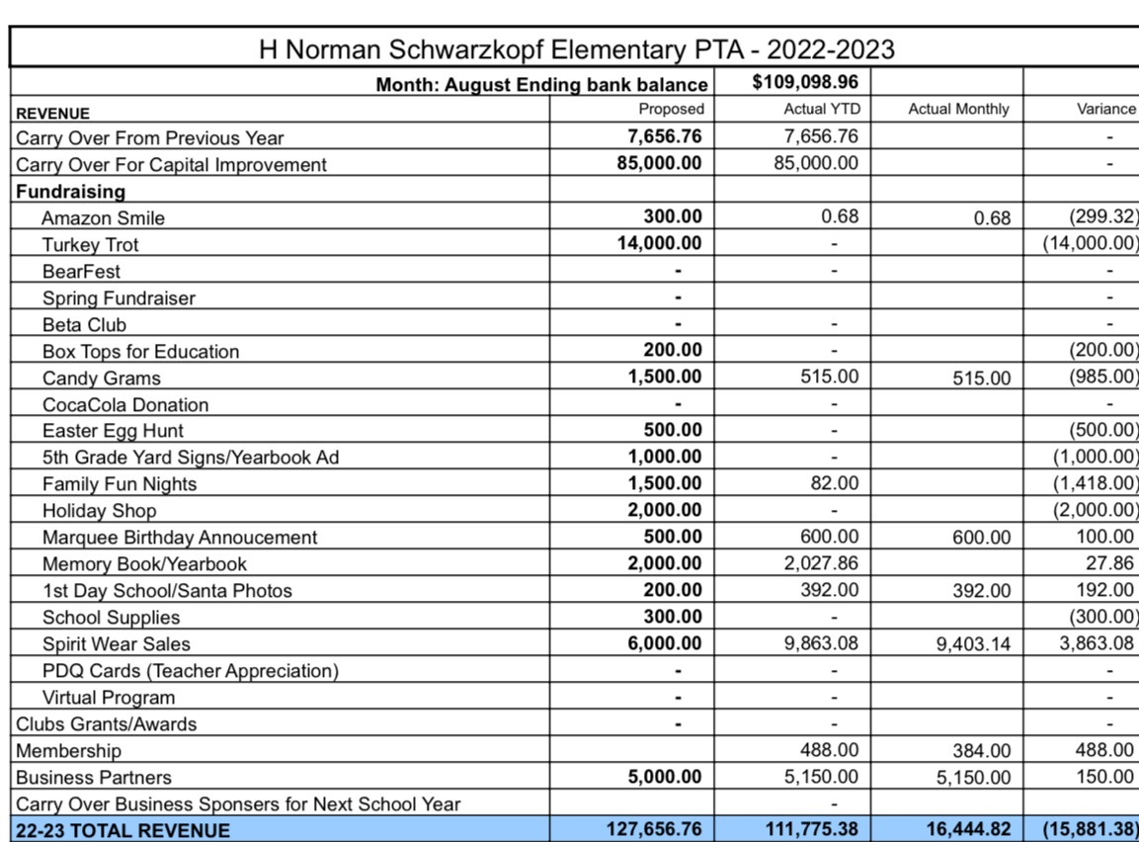
Budget Report August 2022

Slide 5
THANK YOU FAMILY AND BUSINESS SPONSORS for your support! Go Bears!!
The Medina Family
The Pricer Family
The Seehawer Family
The Ruhe Family
The Grim Family
The Fujimoto Family
The Evans Family
The Robinson Family
The Jones Family
The McGuinness Family
The Smith Family
The Grever Family
The Metcalf Family
The Meza Family
The Noori Family
The McDonnell Family

